Slide 1


Shield
Insurance
Analysis
A pilot project in Power BI presented by
AtliQ Technologies Pvt. Ltd.

Slide 2

Agenda
1
Introduction - About Company
2
Problem Statement
3
Report Overview
4
Insights & Recommendations

Slide 3
Introduction - About Company
Shield Insurance is a renowned provider of comprehensive coverage solutions, committed to protecting individuals and families from life’s uncertainties.
With a broad spectrum of flexible and affordable policy options tailored for every age group, the company ensures peace of mind through every life stage.
Guided by a customer-first philosophy, Shield Insurance designs policies that are easy to understand and thoughtfully aligned with diverse lifestyle needs.
Currently, the company operates across five major cities—Indore, Delhi NCR, Chennai, Hyderabad, and Mumbai—ensuring nationwide accessibility through its four dynamic sales channels: Offline Agents, Offline Direct Services, an Online App, and a user-friendly Online Website.

Slide 4
Problem Statement
Shield Insurance aims to deepen its understanding of customer demographics, revenue streams, and sales performance across diverse age groups, geographic locations, and sales channels.
By identifying critical growth patterns and monitoring performance over time, the company seeks to uncover strategic insights that will inform business decisions and enhance customer engagement.
To strengthen its data-driven decision-making capabilities, Shield Insurance plans to implement an interactive dashboard that delivers clear, actionable intelligence.
And, as the part of this initiative, the company has proposed a pilot project with AtliQ Technologies to evaluate the feasibility and impact of this digital solution.

Slide 5
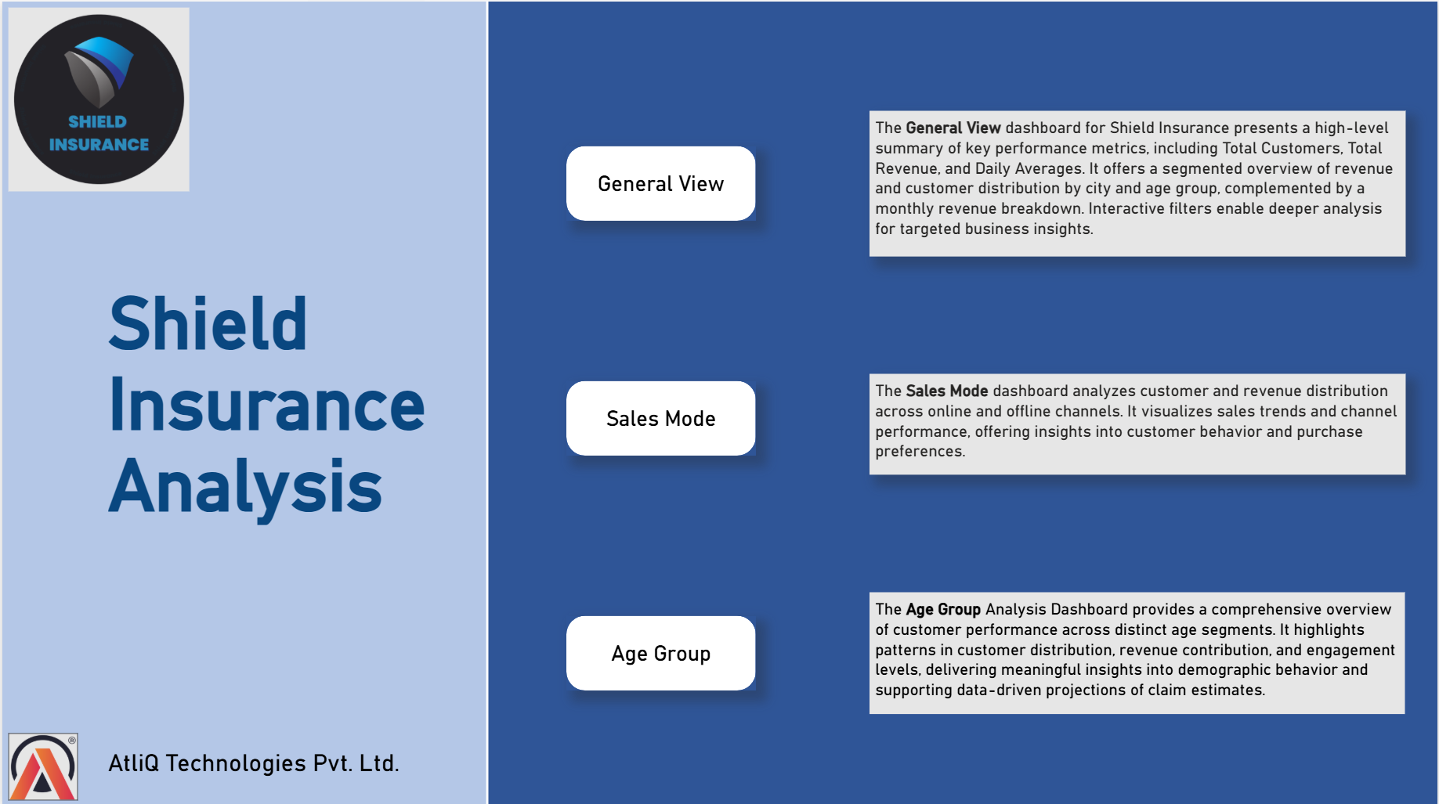
Report Overview -
Home Page

Slide 6
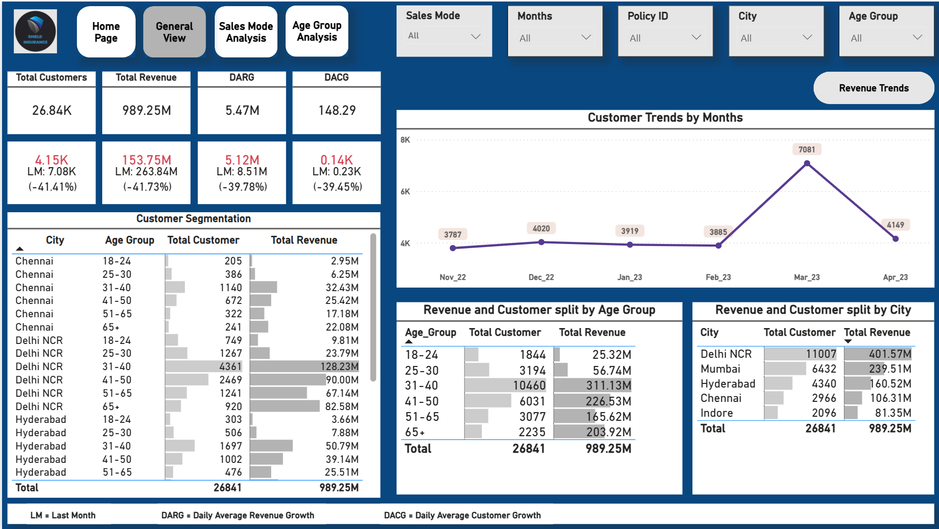
General View Dashboard

Slide 7
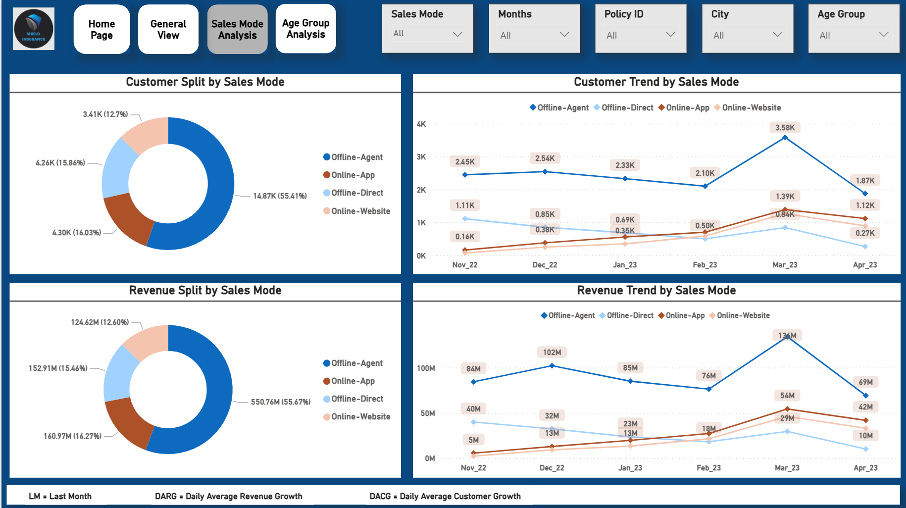
Sales Mode Dashboard

Slide 8
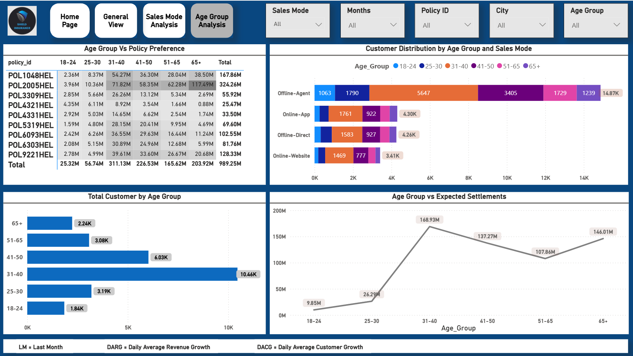
Age Group Dashboard

Slide 9
Insights
Revenue Overview -
The company achieved a total revenue of ₹989.25 million over the 6-month period.
March emerged as the highest-performing month with revenue peaking at ₹263.84 million.
April marked the lowest revenue, dipping to ₹131.69 million—suggesting a sharp post-peak decline.
Monthly Trend Observations -
Both revenue and customer acquisition peaked in March, signaling successful campaign execution or seasonal factors.
However, the subsequent decline in April warrants attention—possibly due to operational bottlenecks or market shifts.
Age Group Segmentation -
The 31–40 age segment generated the highest revenue at ₹311.13 million, indicating high purchasing power and engagement.
In contrast, the 18–24 age group contributed just ₹25.32 million, pointing to lower conversion rates or reduced financial capacity.
City-Wise Performance -
Delhi NCR led with the highest revenue contribution, showcasing strong regional performance.
Indore reported the lowest revenue, highlighting an opportunity for targeted market development and strategy enhancement.
Customer Growth -
A total of 26.84K customers were onboarded, reflecting strong market penetration and brand resonance.
The significant volume of new registrations indicates successful outreach and customer engagement strategies.

Slide 10
Insights
Offline Agent Channel -
The Offline Agent mode leads across all channels, contributing the highest share of both customer acquisition and revenue.
Performance peaked in March, indicating a successful mobilization or incentive strategy.
However, April witnessed a sharp decline, recording the lowest figures in both metrics—suggesting possible challenges in field operations or seasonal fatigue.
Online Channel (App & Website) -
The digital platforms demonstrated consistent upward growth throughout the period.
Both customer base and revenue climbed steadily from November to April, underscoring strong digital adoption and effective online conversion strategies.
This channel’s momentum suggests a scalable and resilient model for future growth.
Top & Bottom Performing Policies -
POL2005HEL emerged as the top-selling plan, generating an impressive ₹324.26 million in revenue—indicating strong market preference and positioning.
In contrast, POL4321HEL recorded the lowest revenue at ₹25.47 million, pointing to low traction and potential for repositioning or review.
Settlement Potential by Age -
Claim settlement potential is highest within the 31–40 age bracket, aligning with their policy uptake.
Interestingly, the 65+ segment ranks second, highlighting elevated risk exposure or policy maturity levels—crucial for forecasting future payouts and reserve planning.
Offline Direct Channel -
This channel showed a steady downward trend from November to February, in both revenue and customer engagement.
A brief surge in March hinted at tactical improvements or one-off campaigns.
Yet, the rebound was short-lived, as April’s data reflects a return to lower levels—calling for strategic reevaluation of this touchpoint.

Slide 11
Recommendations
Product Portfolio Fine-Tuning -
Reposition or revamp low-performing policies like POL4321HEL through revised benefits, bundled offerings, or tiered pricing.
Promote top-performers such as POL2005HEL with targeted campaigns, loyalty bonuses, or referral incentives to boost visibility and repeat purchases.
Sales Channel Enhancement -
Invest in digital channels (app and website) by improving UX/UI, personalizing content, and introducing chat-assisted guidance—leveraging their consistent growth trend.
For Offline Agent channel, address the April dip by providing performance-based incentives, re-training, or localized micro-campaigns.
Offline Direct mode needs strategic realignment: test hybrid outreach models or integrate with digital follow-ups to reduce friction and drop-offs.
Regional Penetration -
Expand successful models from Delhi NCR to adjacent Tier-1 and Tier-2 cities using a geo-targeted expansion strategy.
Explore partnerships, local influencers, or promotional drives in underperforming areas like Indore to enhance brand presence and product relevance.

Slide 12
Recommendations
Demographic Targeting -
Double down on the 31–40 age group with tailored messaging, lifecycle-based insurance packages, and value-added services.
Introduce starter plans or educational campaigns targeting the 18–24 segment—to increase awareness and build long-term brand loyalty.
Claims & Settlement Strategy -
For high settlement-risk groups (31–40 and 65+), optimize claim handling processes and transparently communicate turnaround timelines to build trust and reduce churn.
Launch predictive modeling tools to forecast high-risk clusters and proactively manage reserves and underwriting guidelines.

Slide 13
Thank You

